Slide 1

Inventory Management System for the Oil & Gas Supply Chain using Reinforcement Learning
Dongzuo Tian

Slide 2
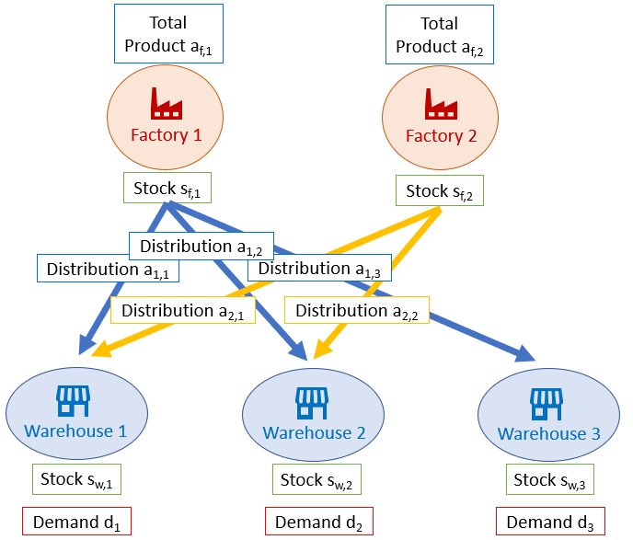
Background
Factory-warehouse network
Demand unknown for the current time
Stocks at both factory and warehouses
Policy to determine the total production number and distribution number to each warehouses to enlarge the reward
Application to downstream oil & gas supply chain
First time to introduce deep Reinforcement Learning (RL) into such a problem
Fig. 1 Factory-warehouse network

Slide 3
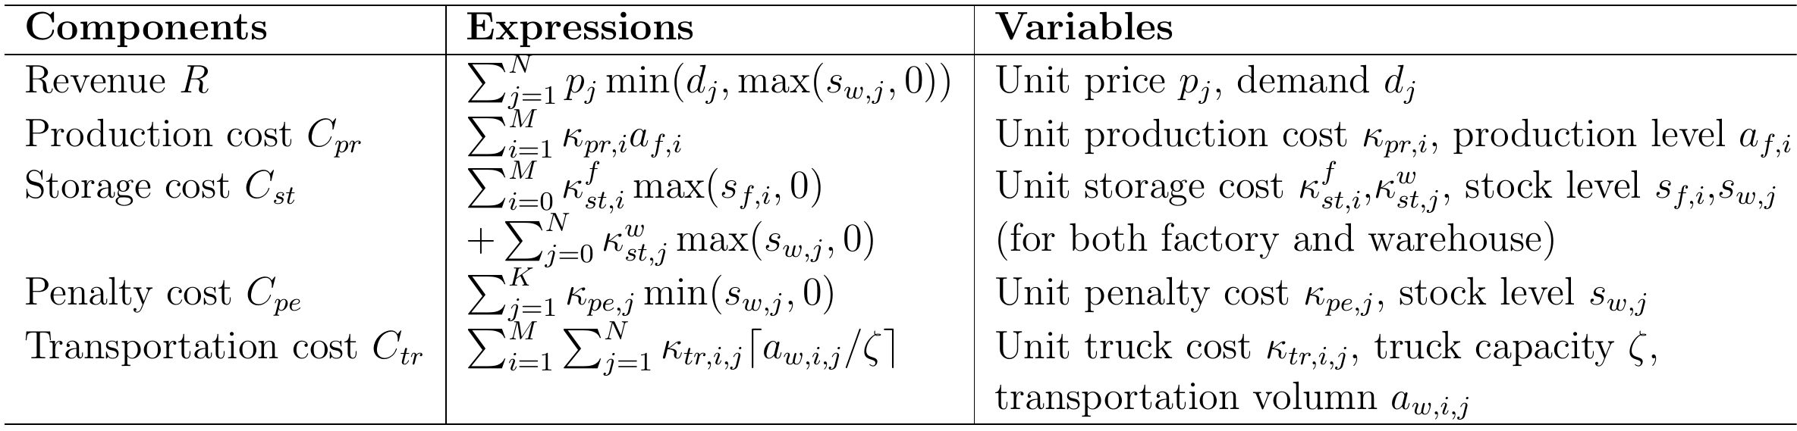
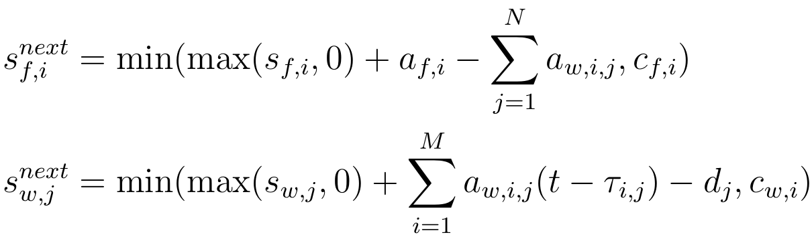
One-step Reward & State Transition
One-step reward:
State transition:

Slide 4
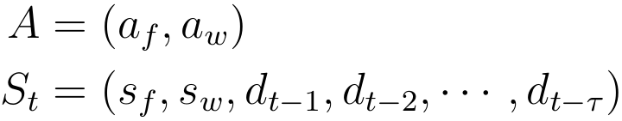
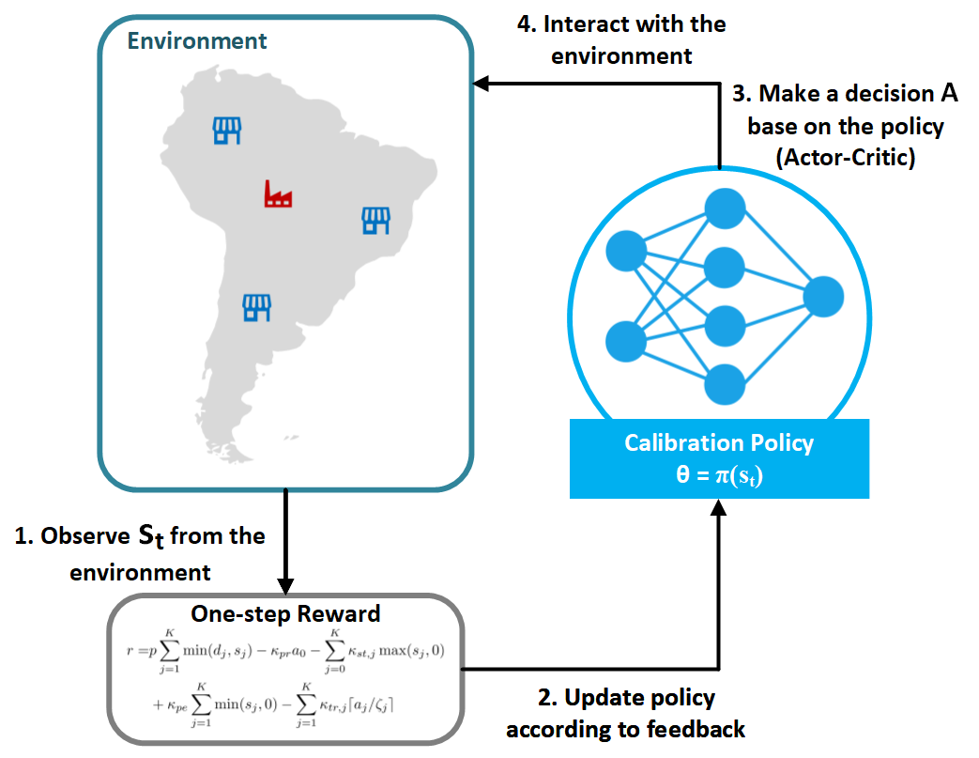
Reinforcement Learning Structure
Action:
State:
Fig. 2 RL in Inventory Management

Slide 5
Actor-Critic Network
Choose Soft Actor-Critic (SAC) as the RL algorithm (2019)
Include target network, replay buffer and entropy control tricks
Programming: RL using Tensorflow & Environment simulator in Python
Make Decision
Give Evaluation
Fig. 3 Actor-Critic network structure

Slide 6
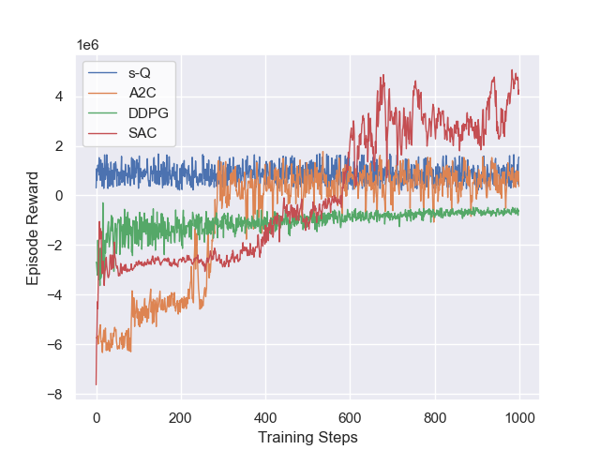
Simulation Results:
s-Q: Once the stock is less than s, it will replenish an amount of Q (Statistic)
Advantage Actor Critic (A2C): Vanilla version of RL
Deep Deterministic Policy Gradient (DDPG): Easily fall into local minima
Soft Actor Critic (SAC): Better exploration strategy using entropy control
Fig. 4 Episode rewards of the 1-Factory 2-Warehouse case

Slide 7
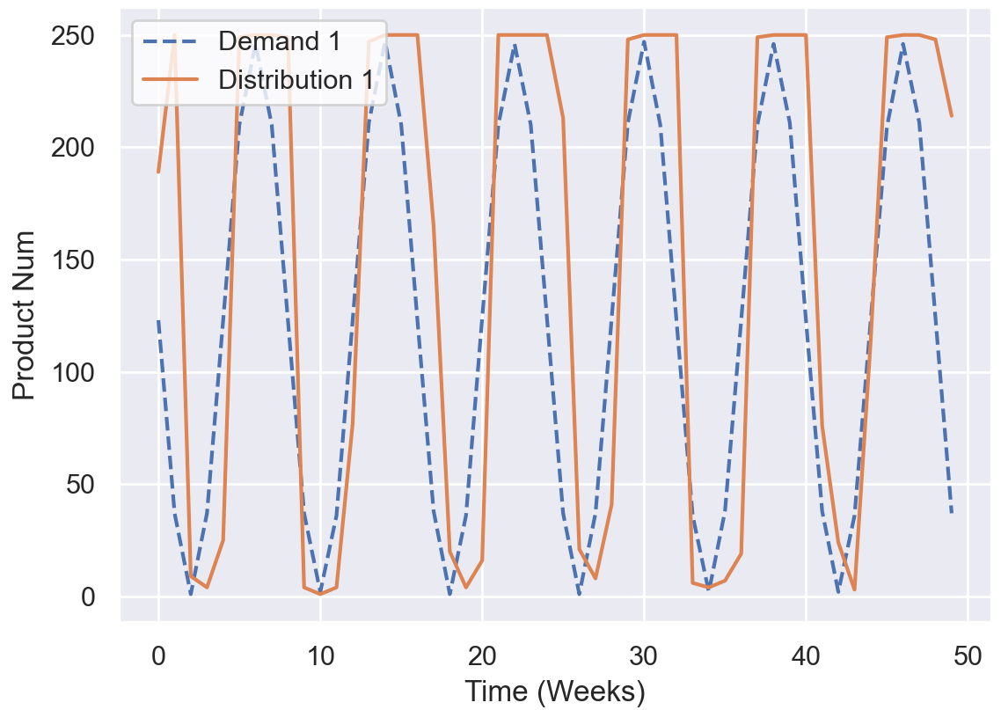
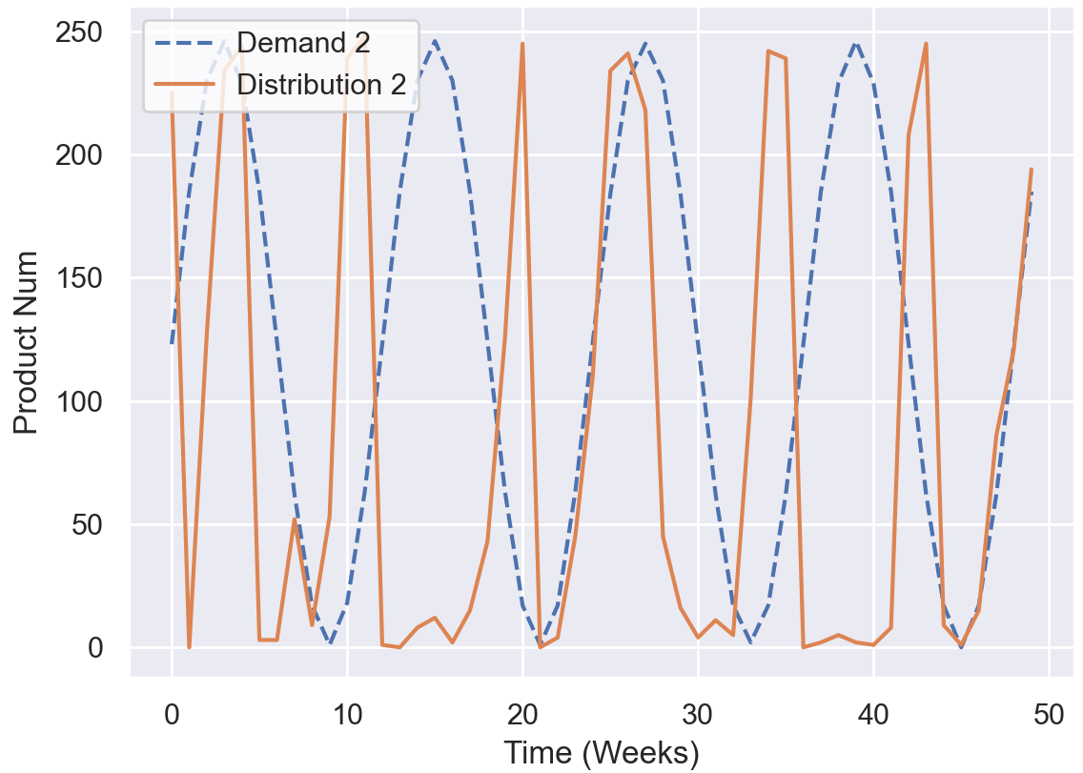
Simulation Results
Demand & distribution of different warehouses (using SAC)
Fig. 5 Demand and distribution profiles of warehouse 1
Fig. 6 Demand and distribution profiles of warehouse 2
Repo posted on: https://github.com/DDoTian/SupplyChain_RL

